Slide 1
Female Reproductive Endocrinology

Slide 2
Male & Female Reproductive Systems
are functionally different
Female produces 1 gamete per month:
retains and nurtures zygote
Male disseminates large quantities of gametes:
produces 1/2 billion sperm per day

Slide 3
The Female Reproductive System
Produces sex hormones and functional gametes (oogenesis and ovulation)
Fertilization- allowing the sperm and oocyte to meet and fuse
Protects and supports developing embryo (pregnancy)
Parturition- expelling the fetus
Nourishes newborn infant (lactation)

Slide 4
Female Reproductive Cycle Hormonal Control
Involves secretions of pituitary gland and gonads
Forms a complex pattern that coordinates ovarian and uterine cycles and affects the breast
Main hormones regulating menstrual cycle:
Follicle stimulating hormone (FSH)
stimulates follicular development
Luteinizing hormone (LH)
maintains structure and secretory function of corpus luteum
Estrogens
have multiple functions
Progesterone
stimulates endometrial growth and secretion

Slide 5
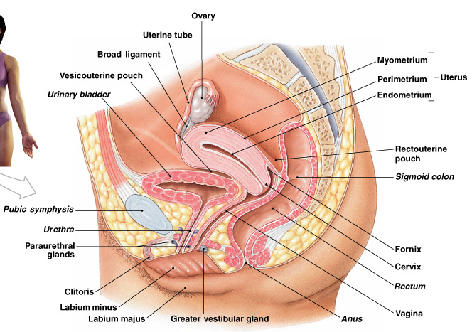
Organs of Female Reproductive System
Ovaries
Fallopian tubes
Uterus
Vagina
External genitalia

Slide 6
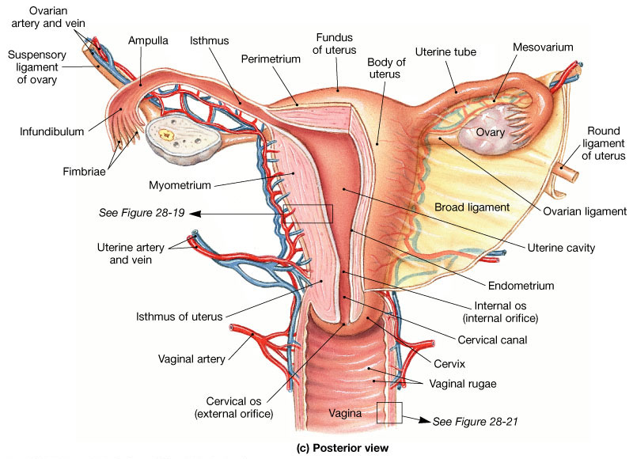
Female Reproductive System

Slide 7
Ovaries
2 almond shaped glands, either side of uterus
5 cm long, 2.5 cm wide, 8mm thick, weigh 6–8 g
they develop & expel 1 ovum/month
there are 2 million primary oocytes in the ovary of a newborn
by adolescence about 40,000 remain
during a lifetime a woman releases about 400 become secondary oocytes and fully mature to eggs for fertilization
the follicles in the ovaries produce the female sex hormones, progesterone and estrogen as well as inhibin
these hormones prepare the uterus for implantation of the fertilized egg

Slide 8
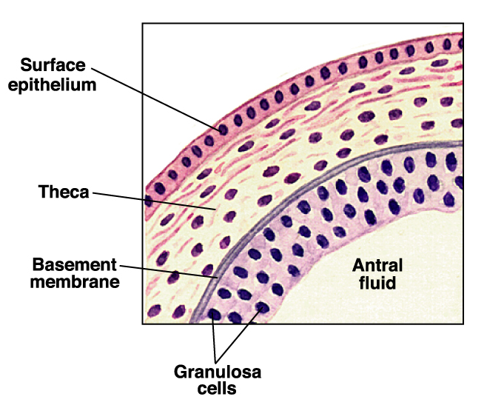
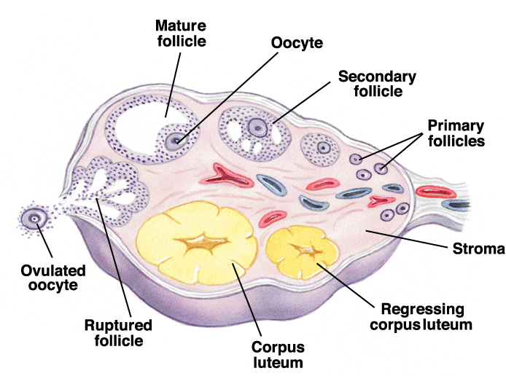
Ovaries
Contain germinal cells
Contain endocrine producing cells
Thecal
Granulosa
Determine secondary structures and sexual characteristics

Slide 9
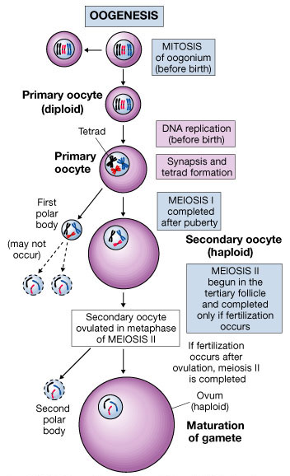
Oogenesis (ovum production)
Begins before birth
Oogonia migrate to ovary from yolk sac
Accelerates at puberty
Ends at menopause
Primary oocytes remain in suspended development until puberty
At puberty:
rising FSH triggers start of ovarian cycle
Each month thereafter:
some primary oocytes are stimulated to develop further

Slide 10
Role of LH in Ovarian Function
Follicular steroidogenesis
Stimulation of androgen synthesis by theca cells
Follicular maturation
Can support terminal stages of follicular maturation
Ovulation
Resumption of meiosis
Ovulation
Luteinization
Maintenance of luteal function

Slide 11
Ovarian Follicles
sac-like structures in the ovaries
Follicle consists of an immature egg (oocyte) surrounded by several follicle cells named according to its stage of development.
Follicle cells support/nourish ova, secrete estrogen.
Primary Follicle - one layer of follicle cells around ovum
Growing Follicle - >1 layer of follicle cells around ovum
Graafian Follicle - mature oocyte, follicle cells have a fluid filled space between them
Corpus Luteum - follicle cells left behind after the ovum has ruptured at ovulation (makes progesterone)

Slide 12
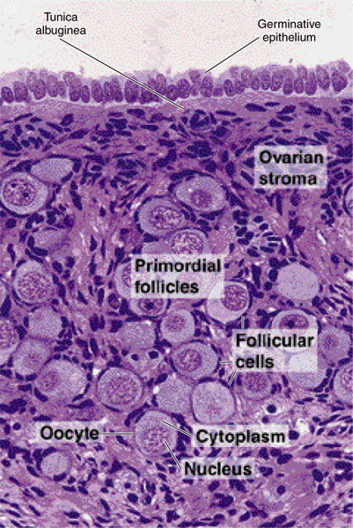
Follicle Development
Primordial follicle
1. primary oocyte
-25 mm diameter
2. single layer of flat follicular (granulosa) cells

Slide 13
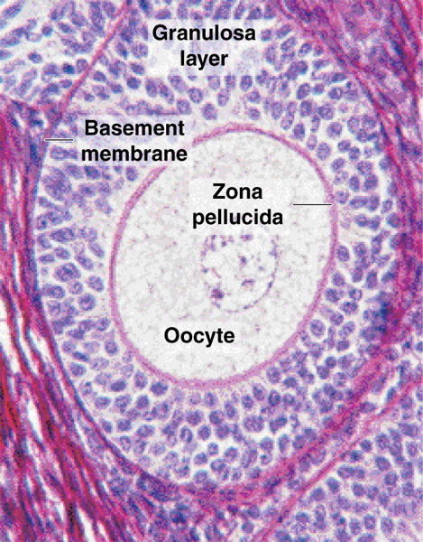
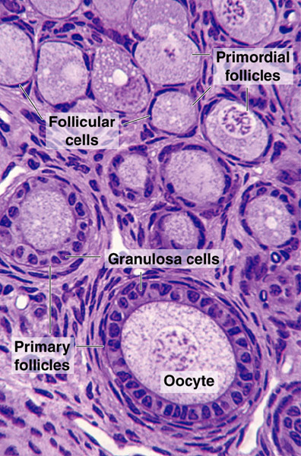
Follicle Development
primary follicle: growth to 125-150 μm diam.
follicular cells: 1 to many layers

Slide 14
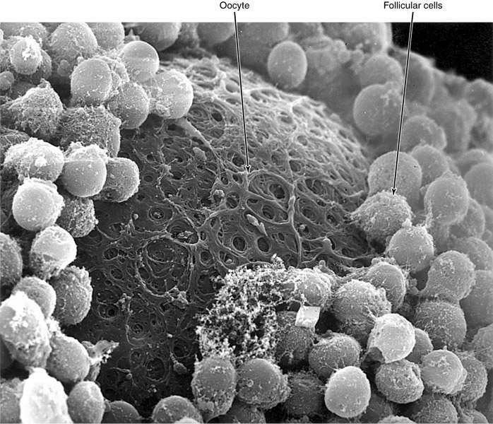
Follicle Development
B. Primary follicle
3. zona pellucida

Slide 15
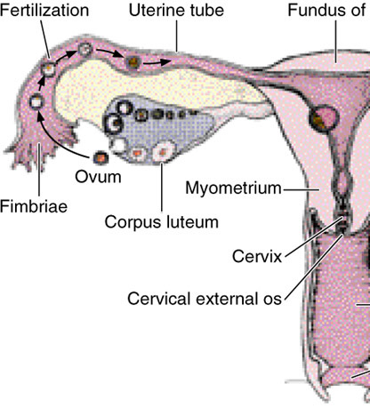
Follicle Development
Ovulation
1. ~ day 14 of menstrual cycle
2. release of ovum with corona radiata
3. received by fimbriae of oviduct
4. fertilization usually in oviduct; this triggers 2nd meiotic division with second polar body
5. male & female pronuclei fuse = zygote

Slide 16
Corpus Luteum
corpus luteum of menstruation
1. when no fertilization occurs: after 10-14 days corpus luteum degenerates
corpus luteum of pregnancy
1. maintained by human chorionic gonadotropin (hCG)
from placenta
2. secretes steroids during pregnancy
3. secretes relaxin
-softens pubic symphysis

Slide 17
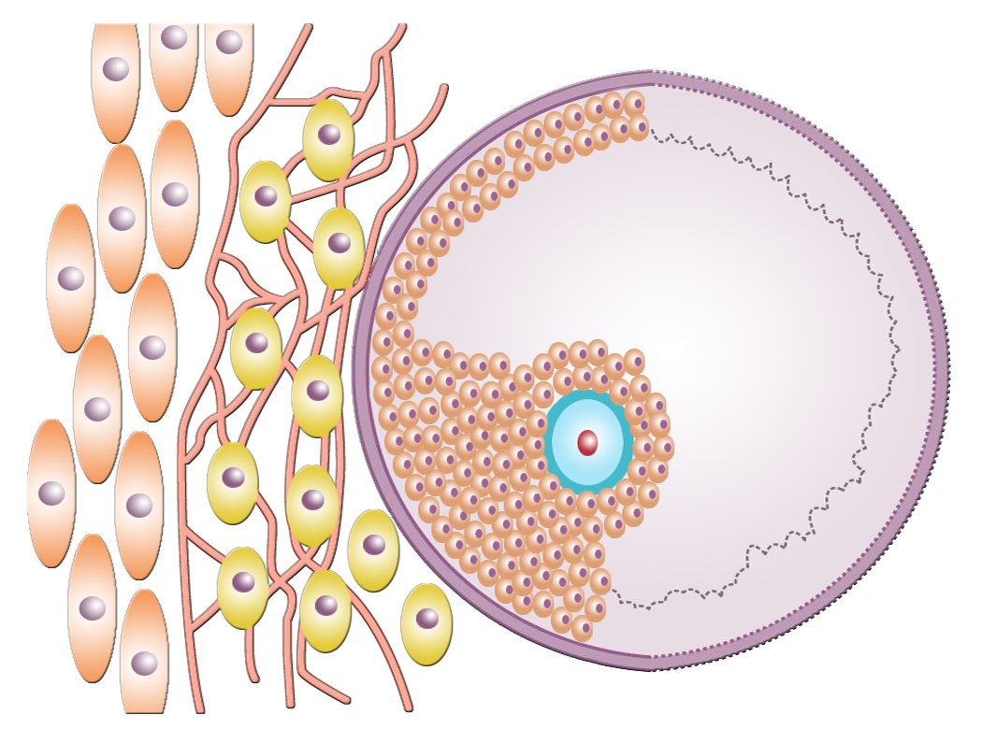
LH and FSH action on the preovulatory follicle
Theca externa cells
FSH receptors on granulosa cells
Theca interna cells
LH receptors on theca cells
Granulosa
cells
FSH
Follicular
antrum
Zona pellucida
Oocyte
Cumulus
Oophorus
cells
LH
E₂
A
Capillary network
Basement membrane

Slide 18
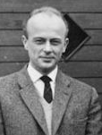
The 2-cell-hypothesis of estrogen synthesis
Bengdt Falck, 1959
Theca cell
Granulosa cell
Malmö, 1927
neuroscientist
LH receptor
FSH receptor
cAMP
Androgen receptor
cAMP
CYP17: 17-Hydroxylase/C₁₇₋₂₀ lyase
aromatase
androstenedione
androstenedione
estrone
cholesterol
testosterone
testosterone
estradiol

Slide 19
Fallopian Tubes
Receive ruptured oocyte from ovary
Fallopian tubes are NOT in direct contact with ovaries
When an oocyte is released from the ovary it moves into the peritoneal cavity. It must reach the mouth of the fallopian tube to be fertilized. A few hours before ovulation, nerves from hypogastric plexus:
“turn on” beating pattern
initiate peristalsis
3-4 days for oocyte from infundibulum to uterus
At ovulation, a current draws the oocyte into the fallopian tube.
finger-like projections called fimbriae
Provide site for fertilization by sperm, usually upper end
10-11 days for the zygote to drift down the tube

Slide 20
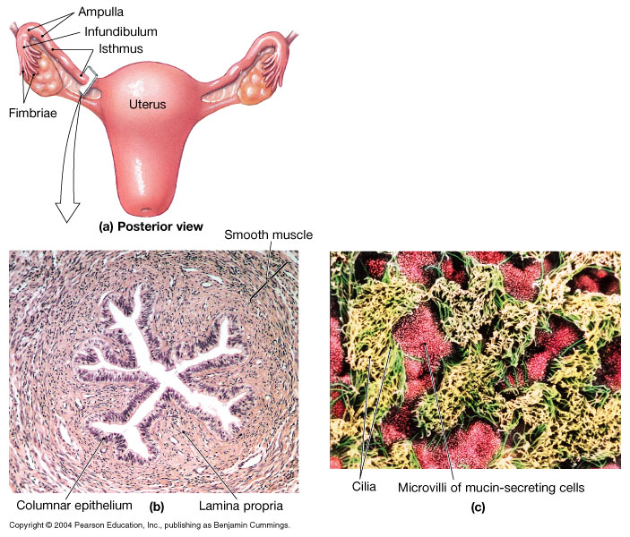
The Uterine Tubes
wall of the fallopian tubes
lined with longitudinal and circular smooth muscle: move oocyte toward uterus
some areas are ciliated
secrete nutritive substances to nourish oocyte

Slide 21
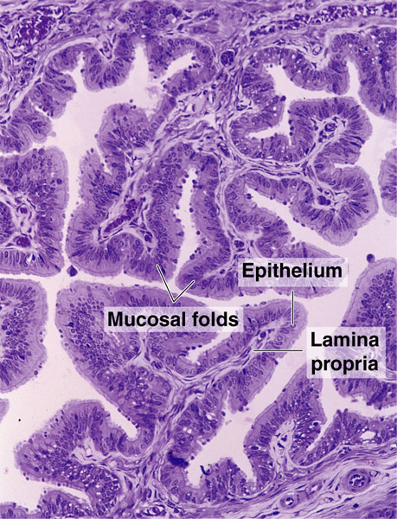
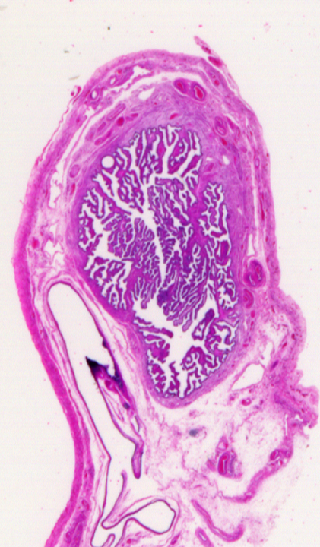
Oviducts
Mucosa
1. longitudinal folds

Slide 22
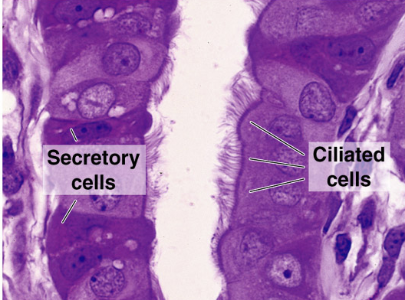
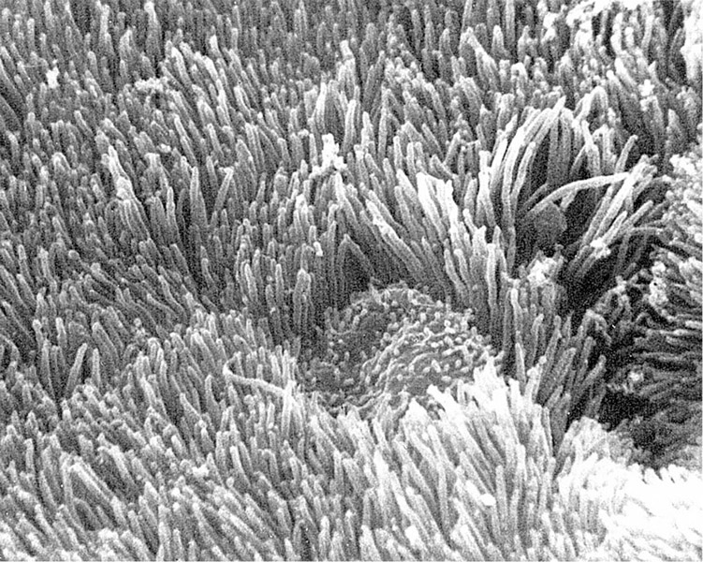
Oviducts
Mucosa: simple columnar epithelium
a. ciliated cells
b. secretory cells
1) supports / transports ovum
2) capacitation

Slide 23
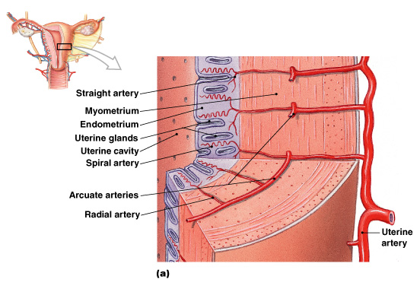
Uterine Cycle The Uterine Wall
thick, outer layer: muscular myometrium
thin, inner layer: glandular endometrium (mucosa)

Slide 24
The Endometrium
contributes about 10% of uterine mass
glandular and vascular tissues support physiological demands of growing fetus

Slide 25
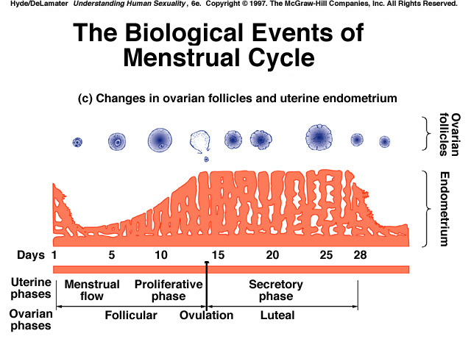

Slide 26
Endometrium: The Proliferative Phase
Epithelial cells of uterine glands multiply and spread across endometrial surface restore integrity of uterine epithelium
Further growth and vascularization completely restores functional zone. Occurs at same time as enlargement of primary and secondary follicles in ovary
Is stimulated and sustained by estrogens secreted by developing ovarian follicles

Slide 27
Endometrium: The Secretory Phase
Endometrial glands enlarge increase secretion
Arteries of uterine wall elongate and spiral through functional zone
Begins at ovulation
Persists as long as corpus luteum remains intact
Generally lasts 14 days
Corpus luteum makes progesterone.
Progesterone:
inhibits pituitary manufacture of LH (and FSH)
“We’ve got successful ovulation, don’t need anymore”

Slide 28
Endometrium: Menses
Is the degeneration of functional zone:
occurs in patches
Is caused by constriction of spiral arteries:
reducing blood flow, oxygen, and nutrients
Weakened arterial walls rupture releasing blood into connective tissues of functional zone
Degenerating tissues break away, enter uterine lumen
Entire functional zone is lost through cervical os and vagina
Is the process of endometrial sloughing
Lasts 1–7 days
Sheds 35–50 ml blood

Slide 29
Reproduction and the Menstrual Cycle
The egg cell is fertile for about 48 hours after ovulation
In general, fertilization occurs on days 14 and 15.
Sperm cells are fertile in the reproductive tubes for about 48 hours.
If pregnancy occurs…
Estrogens and progesterone stay high
FSH and LH stay low, the endometrium continues to grow
Corpus luteum grows and dominates the ovary
Most birth control pills contain the combination of the hormones estrogen (ethinyl estradiol) and a progestins to prevent ovulation: inhibit FSH and LH release

Slide 30
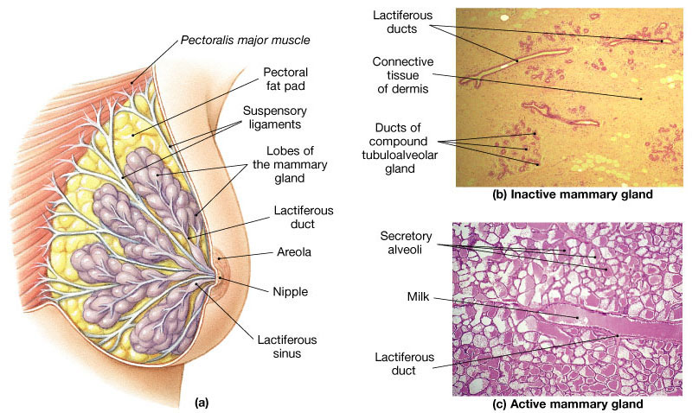
The Breast

Slide 31
Menstrual Cycle
Uterus
Proliferative phase- secretory phase
Ovaries
Follicular phase-luteal phase
Breasts
Quiescent phase- proliferative phase

Slide 32
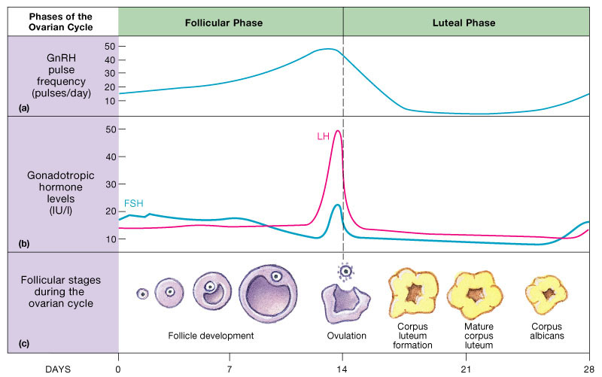
Endocrine Regulation of the Female Reproductive Cycle

Slide 33
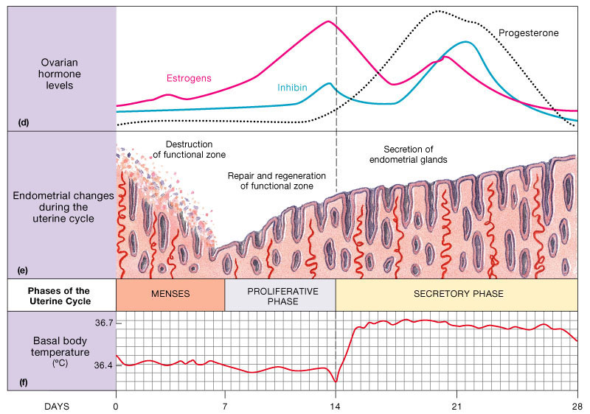
Endocrine Regulation of the Female Reproductive Cycle

Slide 34
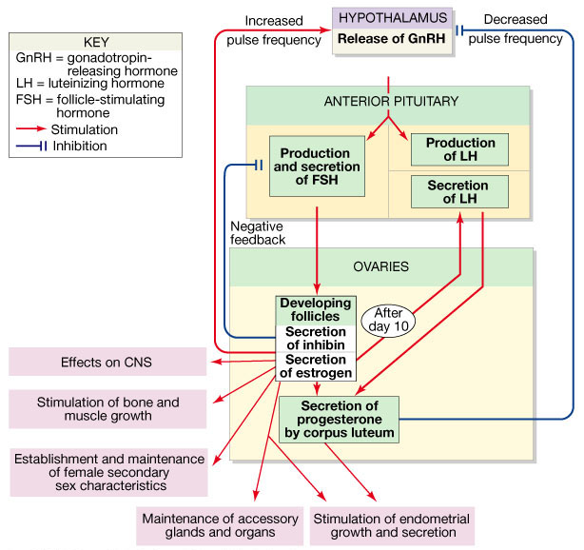
Endocrine Regulation of Ovarian Activity

Slide 35
Human Development
Largely before birth
Most striking changes occur during 3rd-8th week, the embryonic period, at the end of which all major structures are present
Fetal period, 9th week to birth: differentiation and growth of the tissues and organs
After birth:
teeth, breasts
Brain triples in weight between birth and 16 years
Most developmental changes are completed by the age of 25

